Slide 1
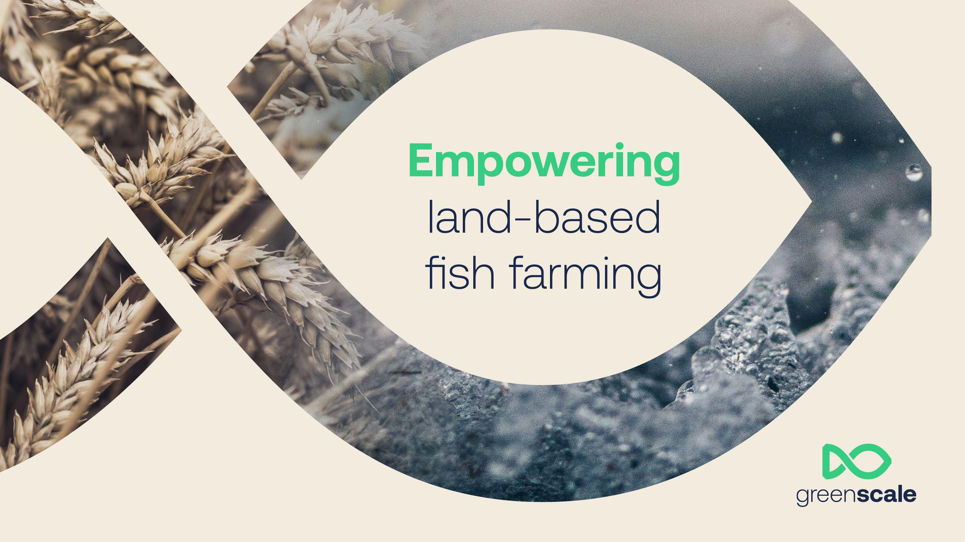

Slide 2
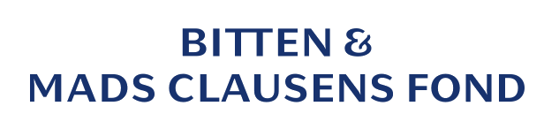
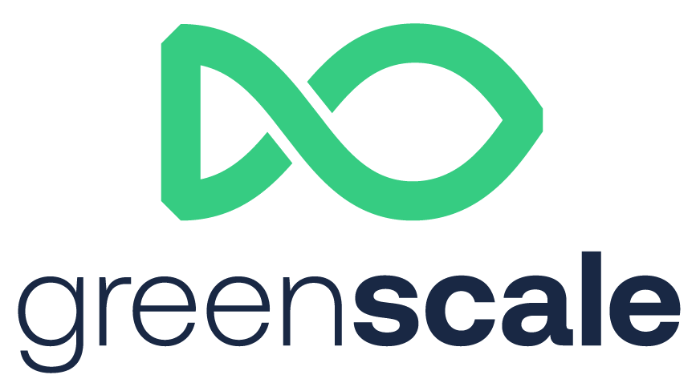
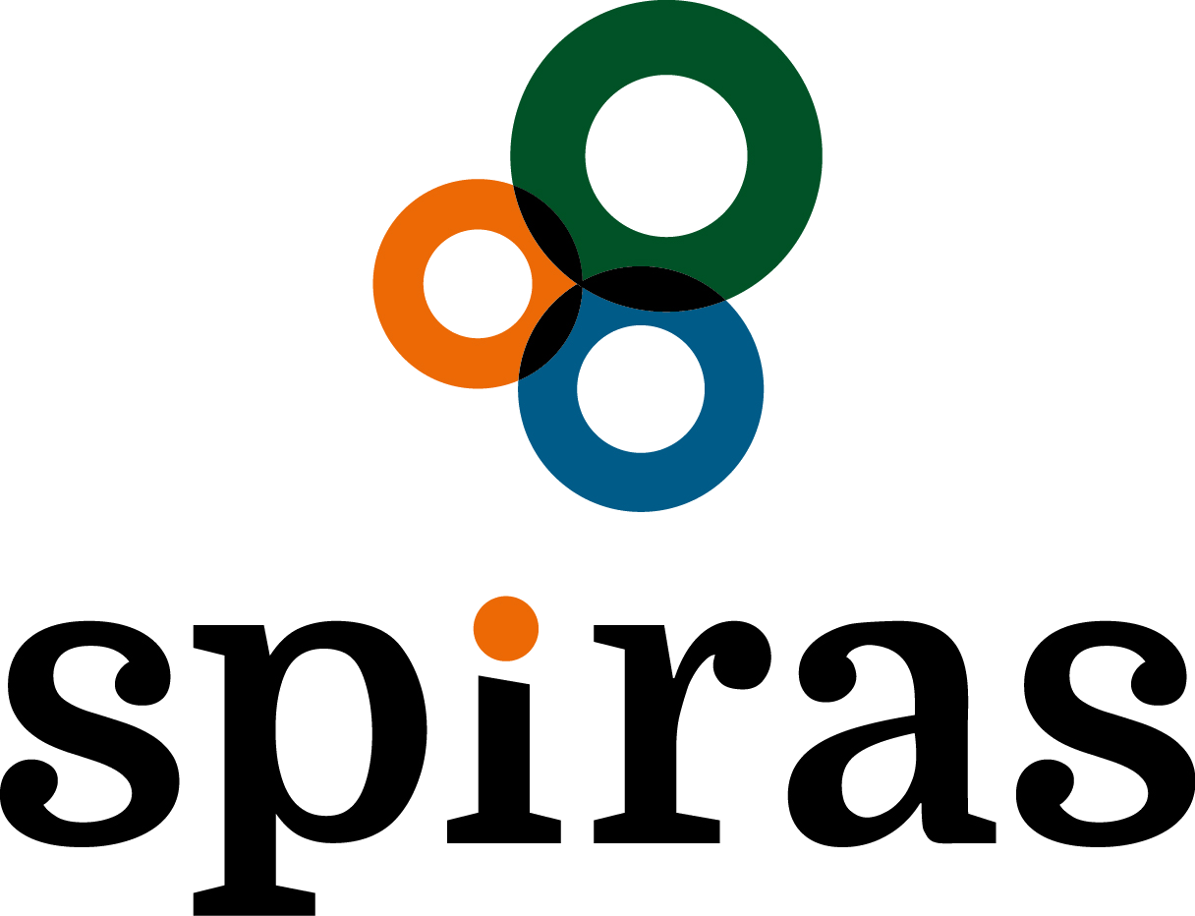
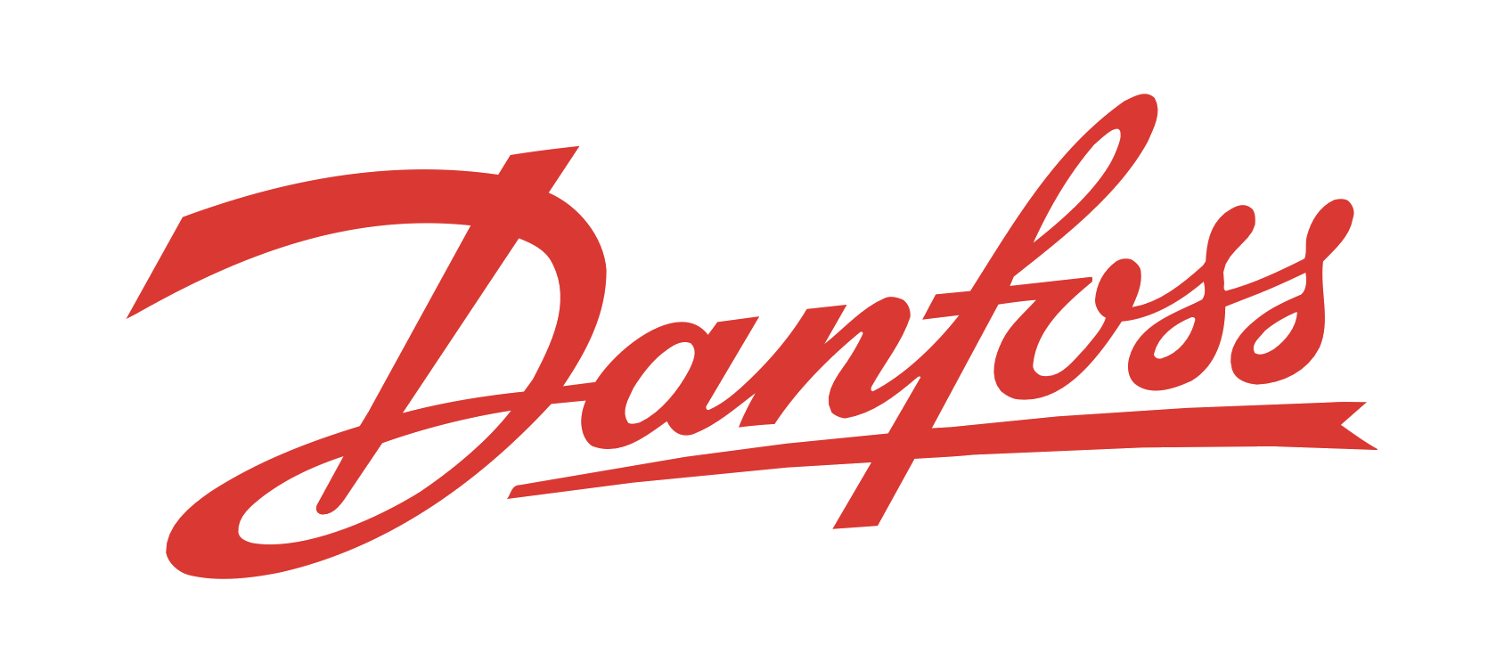
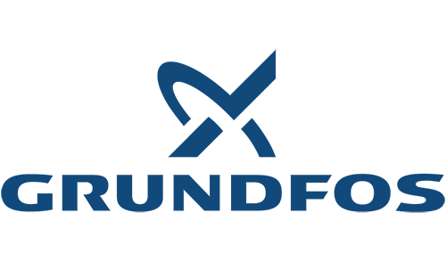
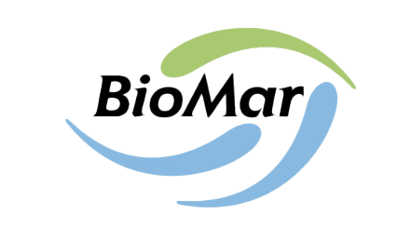
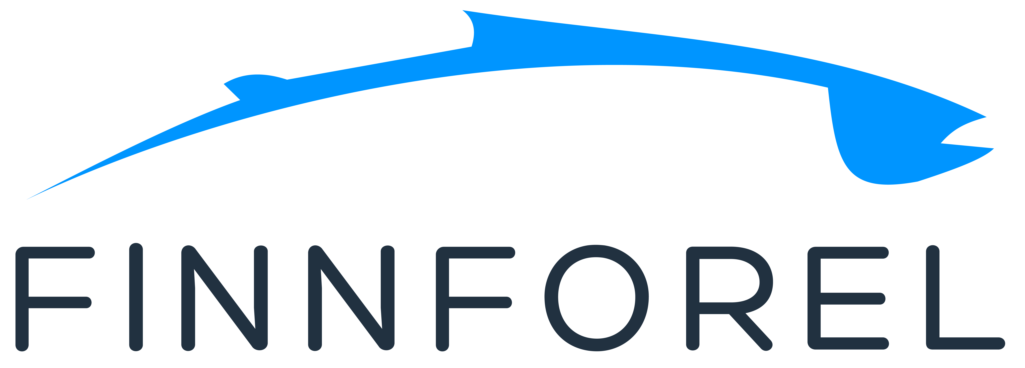
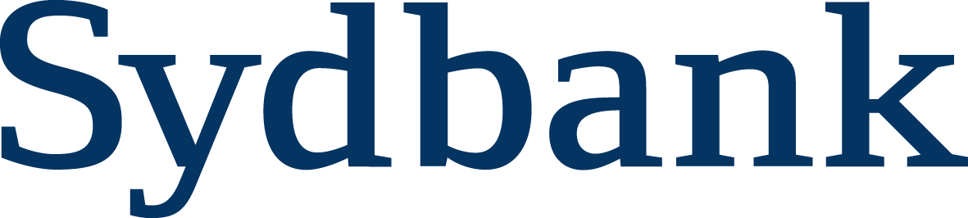
INITIATOR
DEVELOPER OF
FOUNDING PARTNERS

Slide 3
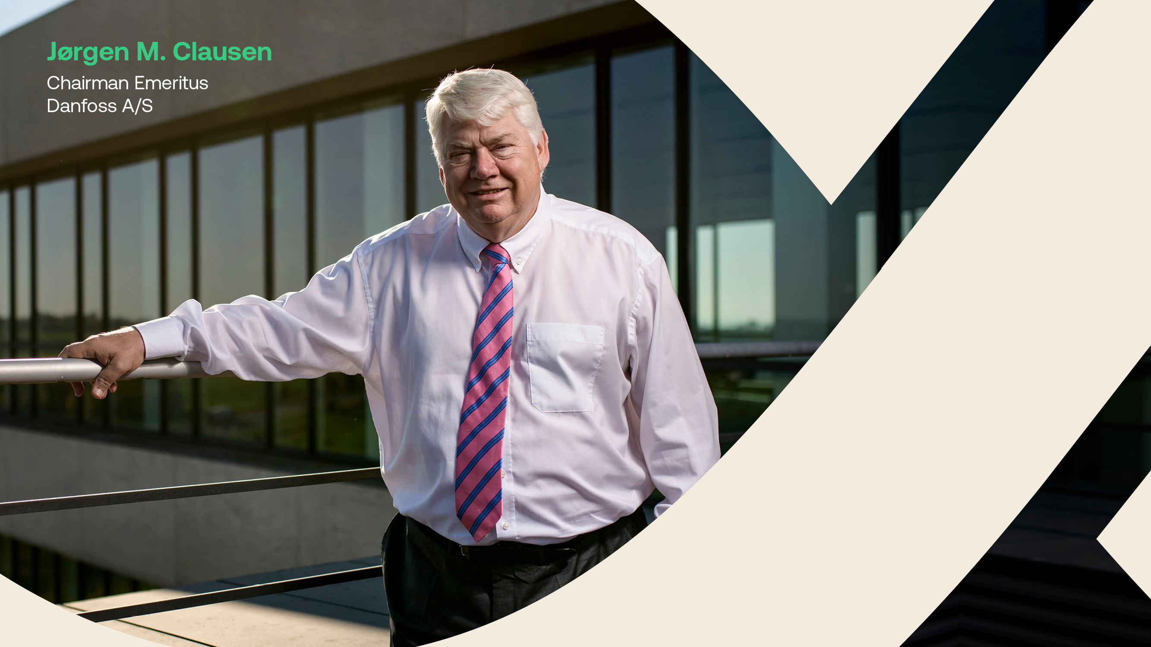
Danfoss is global leading player in energy efficiency
Danfoss was among the first movers in aquaculture
Danfoss Aquaculture is part of the green transition
Danfoss improve the efficiency of aquaculture facilities through programming, insight and technological innovation

Slide 4
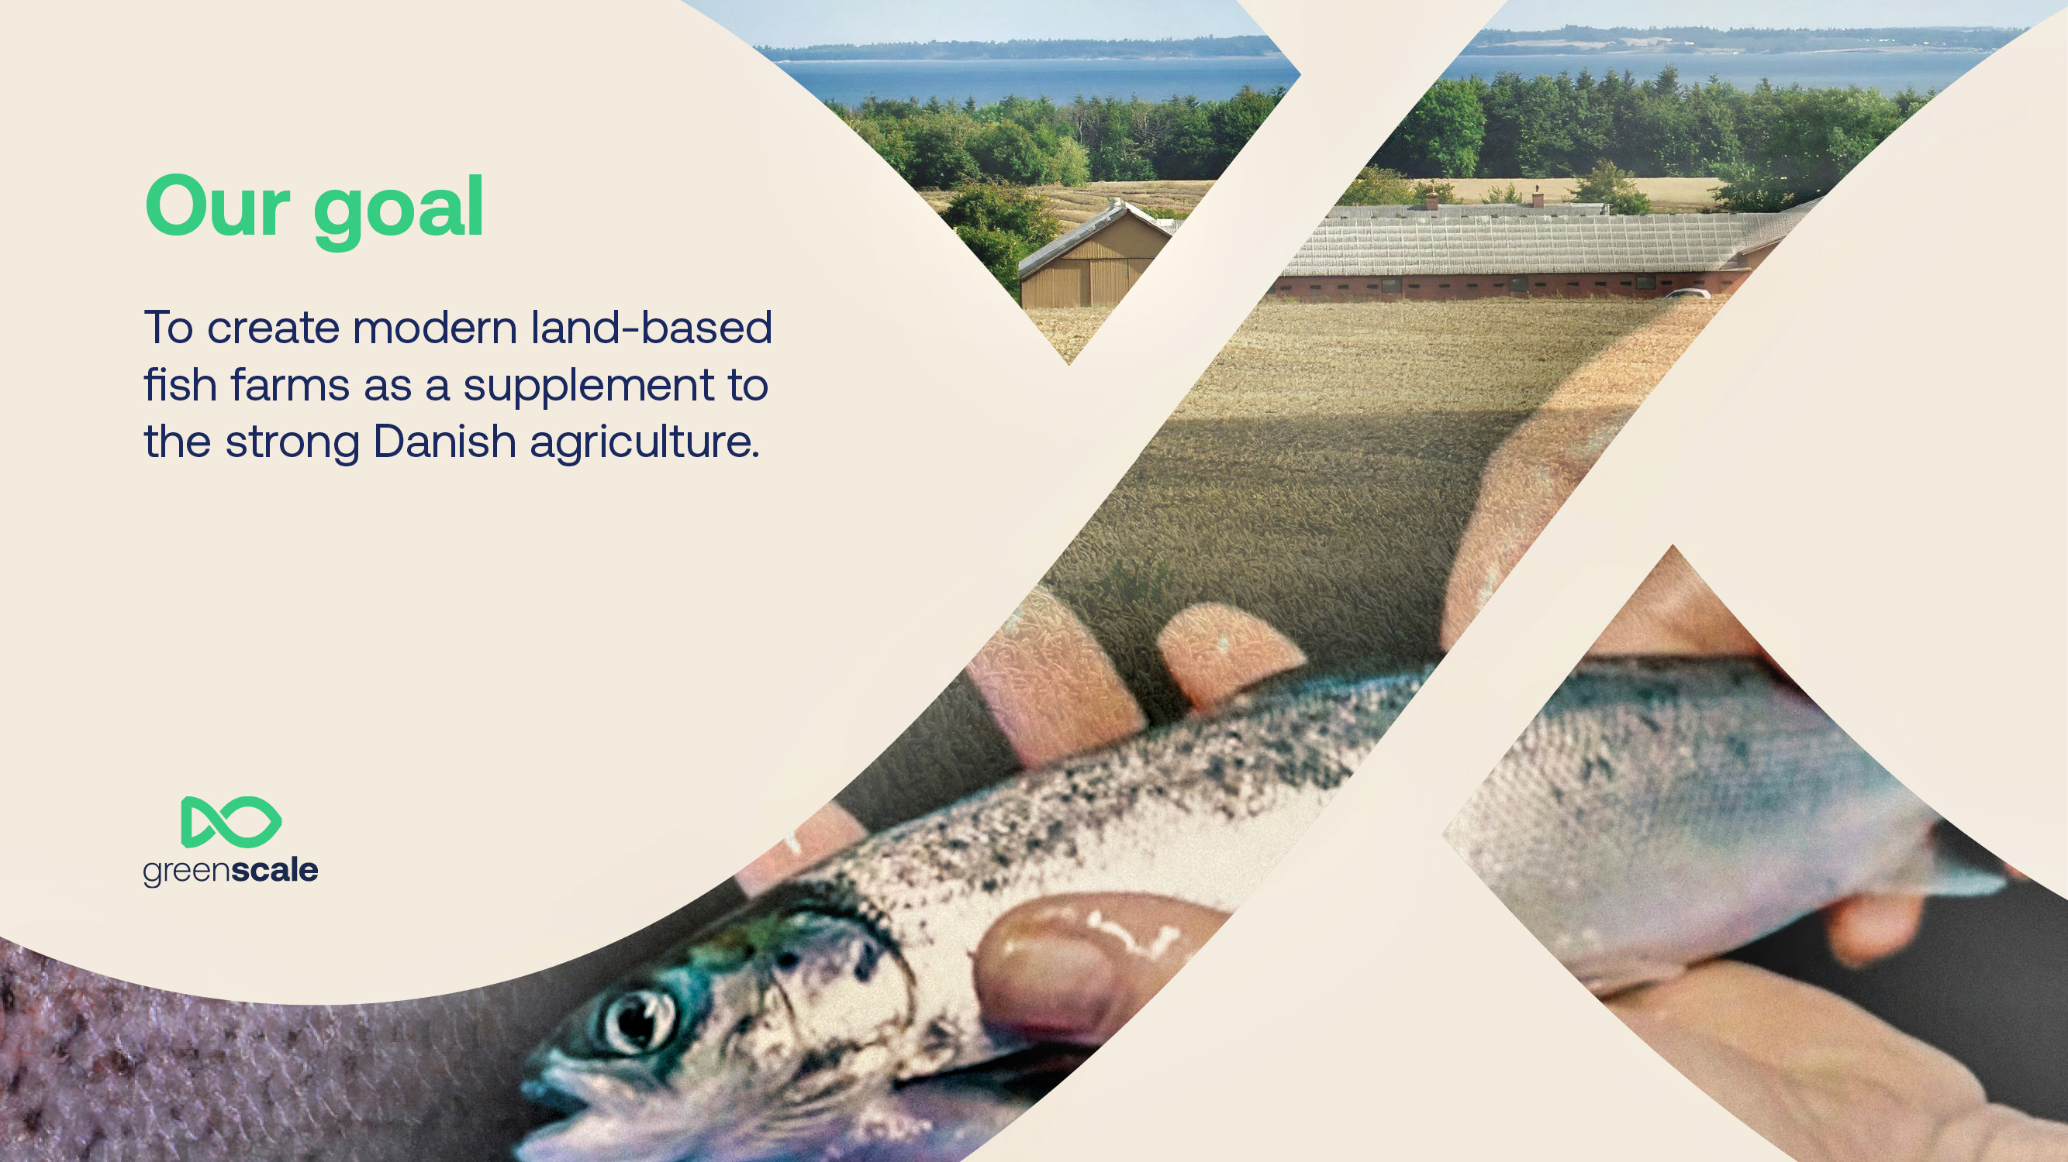

Slide 5
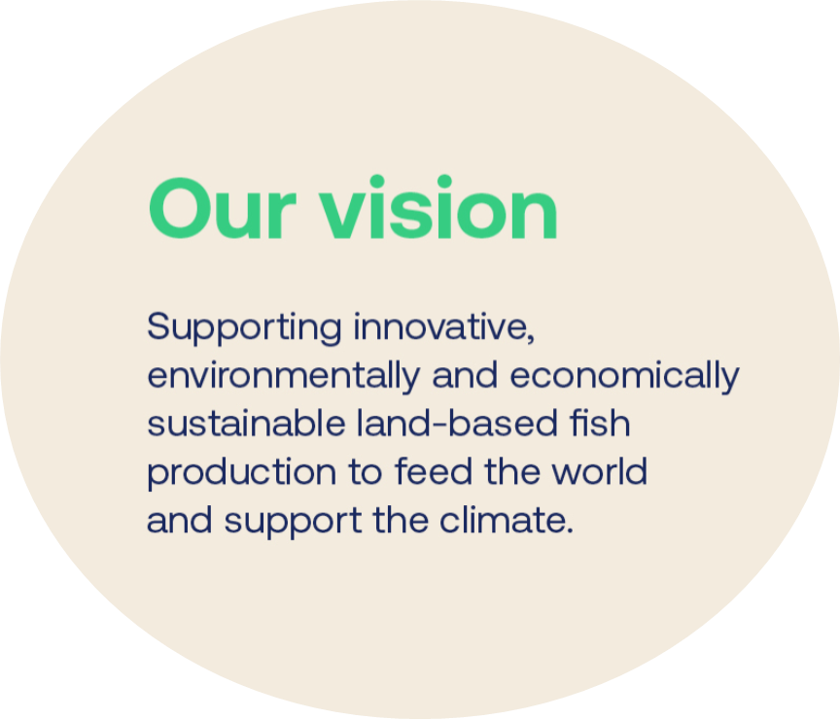
Vision
GeenScale enables the establishment of a global aquaculture industry and technology hub starting in the Southern Denmark region
GreenScale enables Danish farmers to convert parts of current production to fish farming,- acting as a catalyst for more local produced sustainable fish production
GreenScale will support innovation and collaboration among members to implement the vision
Expected effects
Increased income
for the farmers
Reduced
carbon emisson
Reduced
Nutrient discharge
Increased export
of technologies

Slide 6
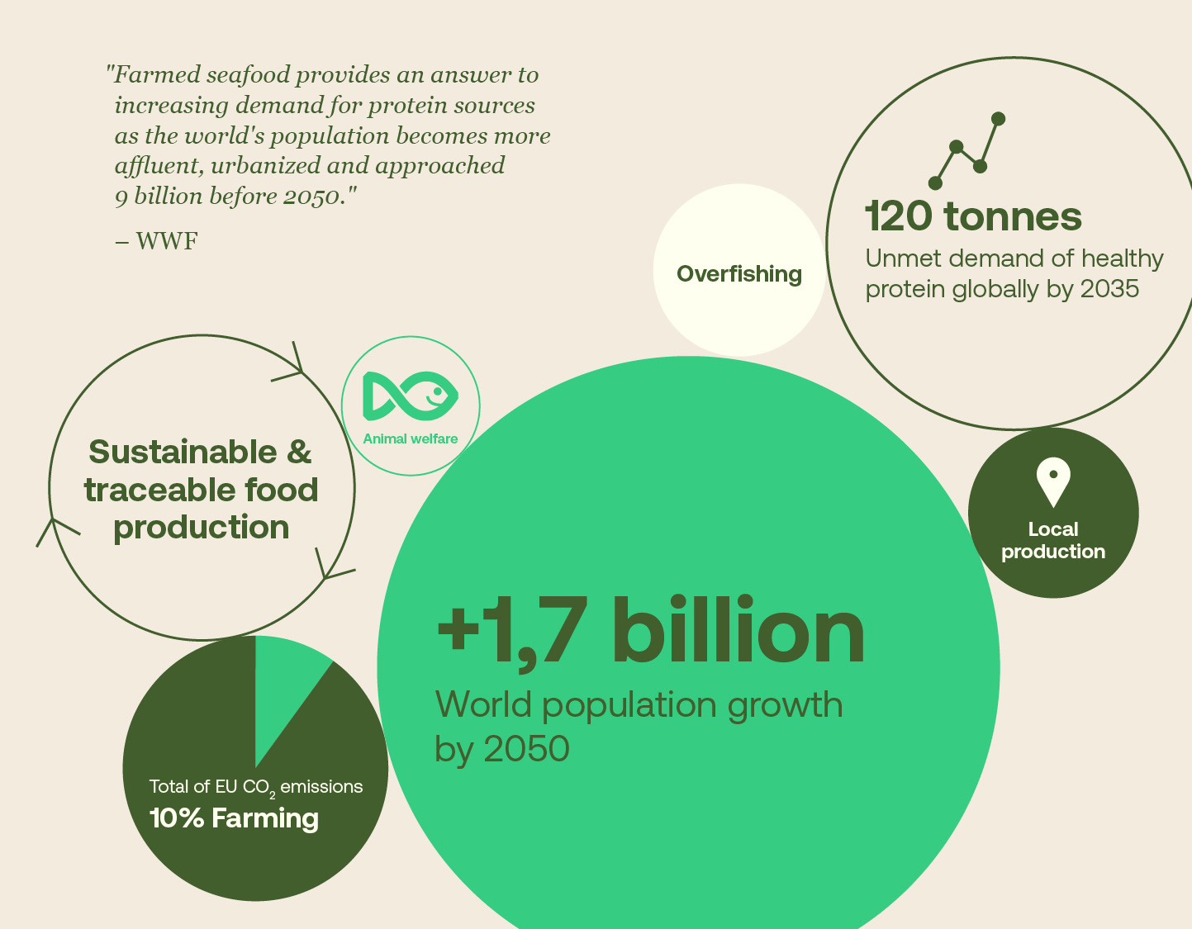
Mega trends overlap
in agri- and aquaculture
Growing population and food scarcity
Demand of sustainable food production
Food safety
Local produce
Traceability
Reduction of carbon and nutrient discharge
Notes:
Agriculture and aquaculture adress common challenges.
By 2050 UN expects us to be 9,7 billion people in the world. That is is about 1.7 billion more than today. The need for protein rises accordingly.
We need to find more a sustainable food production which is transparent, traceable and circular.
Land-based fish farming can be the answer to all of this.

Slide 7
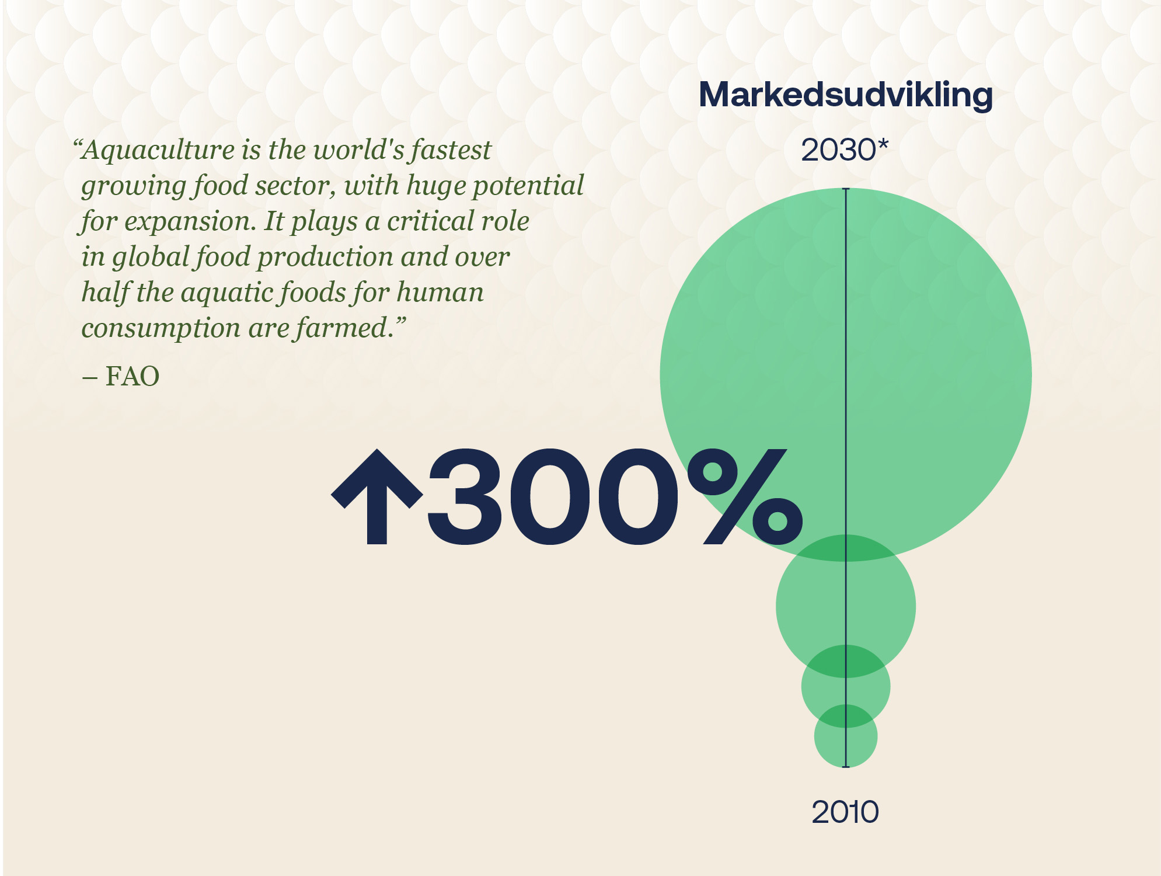
Growing Markets
Markets Development
Worlds population growth increases the need for healthy protein
Great demand for fish in the future
Fast growing market world wide
The Danish consumers should be introduced to local produced fish as a more healthy and sustainable protein source
*Aquaculture Global Market Report 2024,
Research and Markets, February 2024
Notes:
Det, vi kan se, er, at det traditionelle danske landbrug fremadrettet bliver udfordret blandt andet gennem den Grønne Trepart.
Der vil blive stillet skrappe krav til konstant udvikling, og det kan få betydning for konkurrenceevnen på fx svin og kvæg.
Her kan fiskeopdræt være enten et alternativ eller et supplement.
Det globale marked for akvakultur forventes at stige med 300 procent fra 2010 til 2030.
Så hvis vi kan opdrætte fisk i stor skala på land, vil det for stor betydning for miljøet og skabe eksportmuligheder i Sønderjylland.

Slide 8
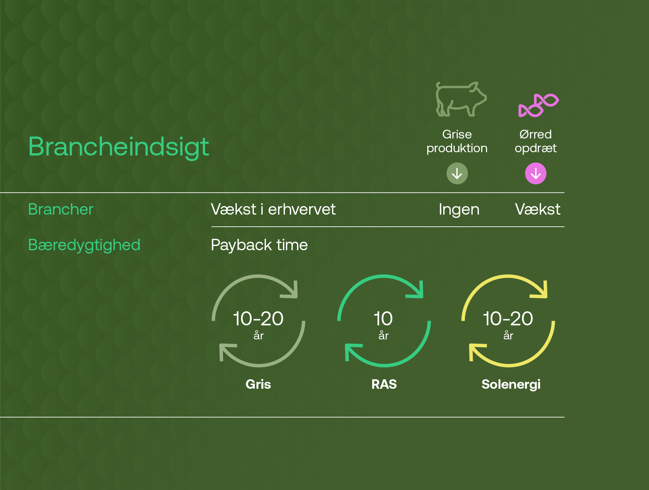

Industry insight
Pig vs. Trout
Little/no growth potential within pig production
Growth potential within fish production
Fish farming is competitive when measured in terms of payback time
Denmark has a history of trout farming
GreenScale will push the market of local produced trout
Industry insight
Industry growth potential
Pay back time
Years
Years
Years
Pig
Solar Power
Notes:
Hvert år bliver der produceret 110 ton svinekød på verdensplan mod kun et ton ørred, så markedet er rimeligt mættet med svin, mens der er masser af plads til fisk.
Men hvis vi sammenholder griseproduktion med ørredopdræt, så kan man se, at paybacktime på en landopdrættet ørred er langt mindre end på gris
Og så er der flere produktudviklingsmuligheder i fiskeopdræt, end der er i gris – som dog har den fordel at det er et meget modent marked.
Rigtig mange landmænd har fået øjnene op for at bruger markerne til fx solenergi. Men der er faktisk længere paybacktime på sådan et anlæg, end der er på et fiskeopdræt.
Jeg har taget fisk med, som vil blive serveret efter oplægget
Stiplads 3200 DKK, afskr. 15 år = 373 forrent+afskr./år
60-70 DKK/gris i kapitalomk. + afkskr.

Slide 9
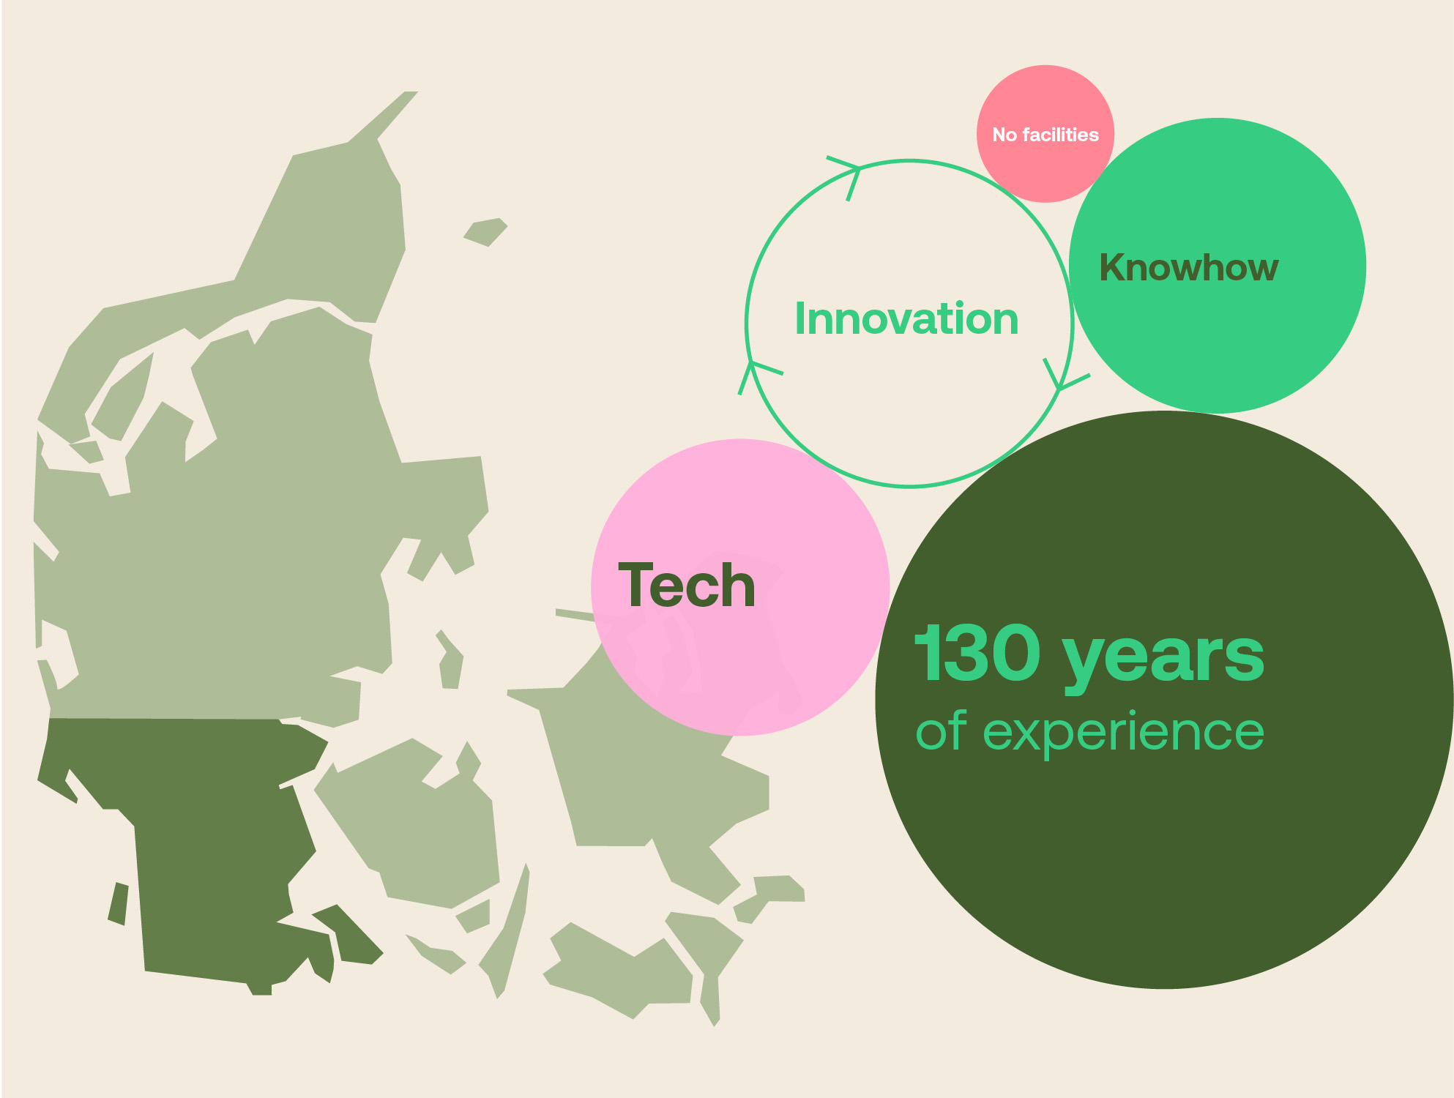
Denmark has a unique position of strength
Some of the worlds leading
aquatech-suppliers are Danish
Denmark has a strong history
of agricultural cooperatives
Combining the agri- and aquaculture creates unique synergies
But currently there is no home market… Yet
Notes:
Norway and Denmark are both leaders in farming fish –
Even if it is not commonly known, and we currently have no home-market, Denmark has a long history with aquaculture.
In fact, Arne Ratchje, one of the fish farming pioneers got the smolt for the first farms on Hitra… from Denmark!
Denmark is very strong in traditional farming.
We are especially very good at organizing farmers in cooperatives that support each other.
Combing the two through the GreenScale hub gives us a unique possibility.

Slide 10
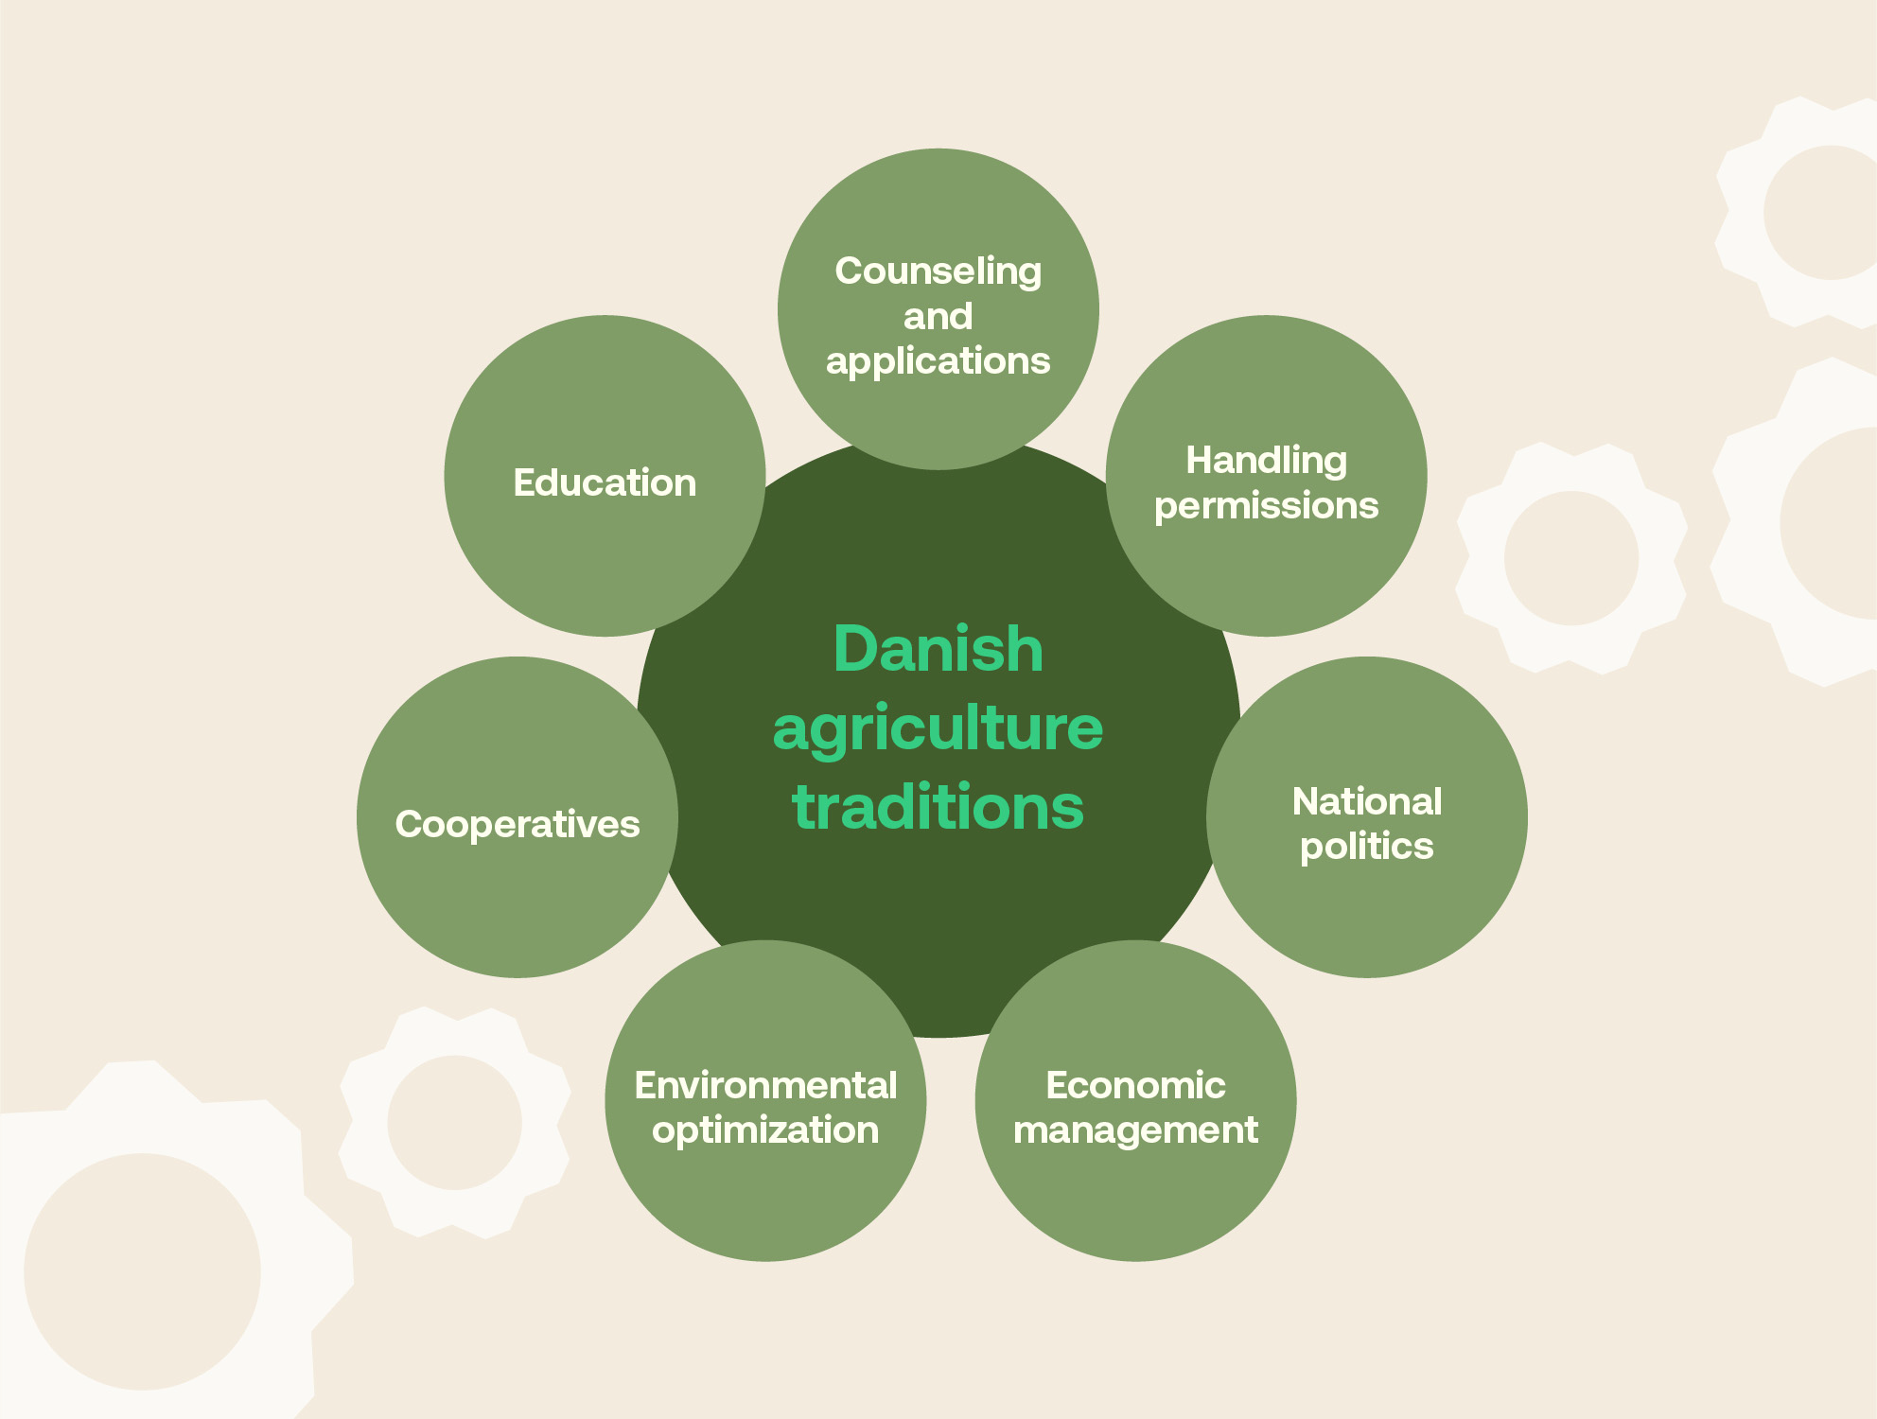
Strengths in the
Danish agriculture
The agricultural organizations
are owned by the farmers
The traditions run deep; from working with national legislators to environmental optimization and education
Danish farmers owns most of the value chain together
Denmark pioneered cooperatives 100 years ago
Farmers has great experience in sharing and using production data
Notes:
In Denmark we have a long history in traditional farming.
This is what has created a world class agricultural production.
We can draw from the experiences in establishing a home market for land-based fish-farming.
The overall infrastructure is in place.

Slide 11
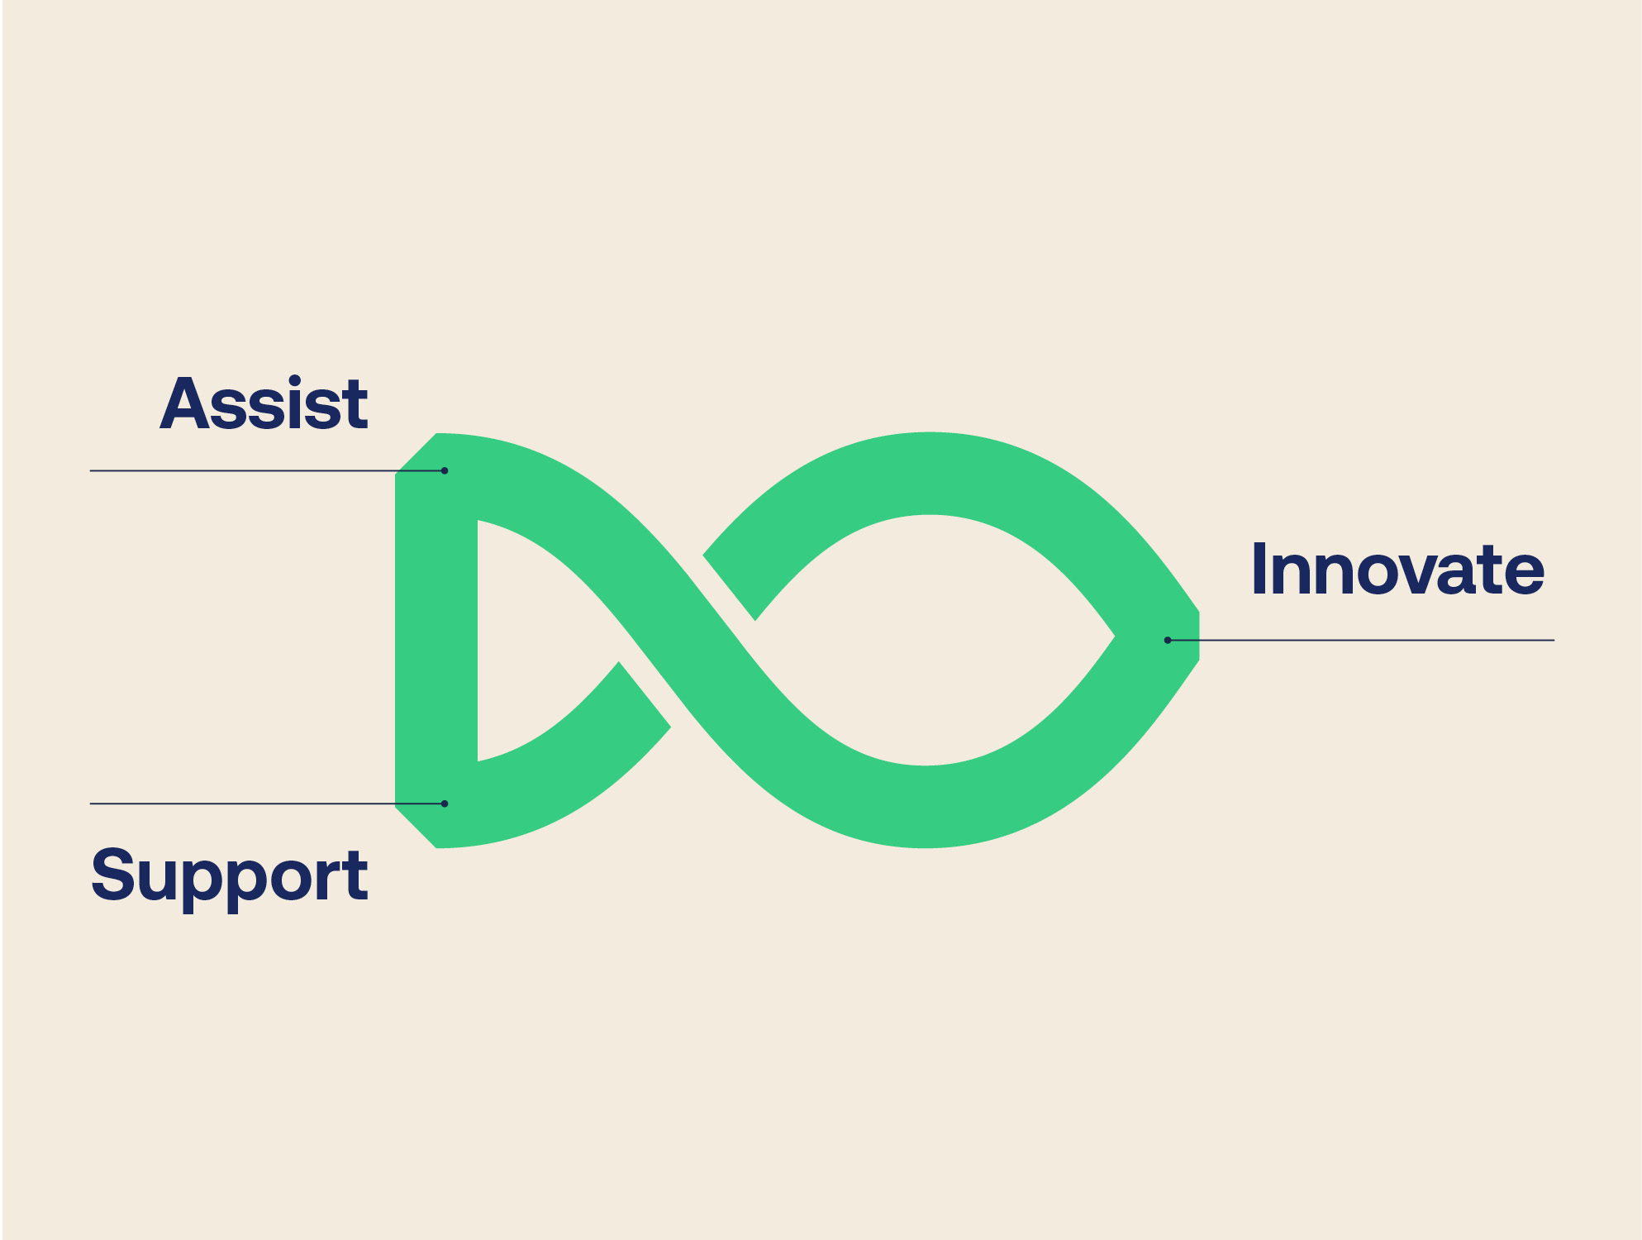
GreenScale primary
focus areas
Assist and support farmers
in producing fish
Support technology export
Lift innovation, technology
and education
Notes:
to assist and support farmers by advising on how to enter joint ventures, work with the authorities and develop pre-approved templates to ease the permitting.
to increase future exports of produce, technology and knowledge.
to lift the level of education, research and innovation in and around land-based fish-farming.

Slide 12
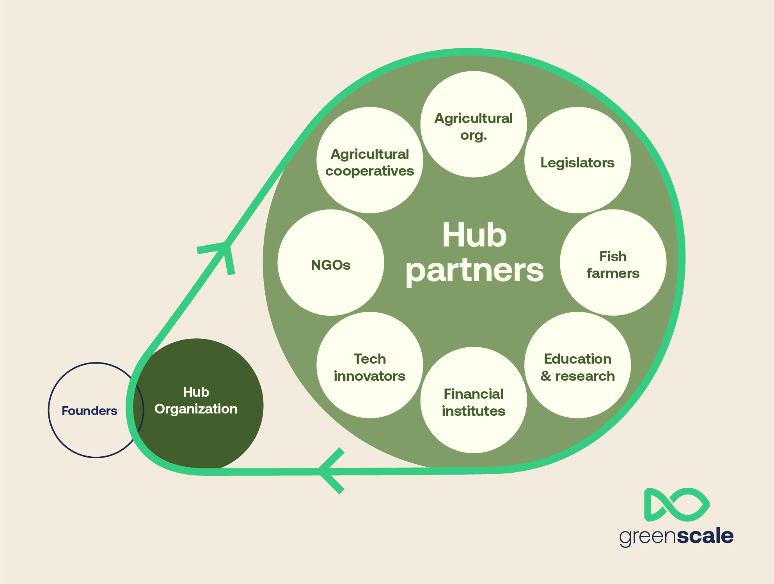
The GreenScale
hub
GreenScale is founded by
big multiple partners
The GreenScale office will organize the stakeholders
in the hub
The Hub will support farmers
with adding land-based fish farming as Recirculated Aquaculture Systems (RAS)
GreenScale will through the hub lift innovation, technology
and education
Notes:
The Hub will gather the supporting industries, hereunder technology providers, processing and retail, fish feed producers and other key partners and stakeholders.
The hub will support developing Scalable Technical Concepts, establish Best in Class aquaculture facilities, and support talent-, technology- and data development.

Slide 13
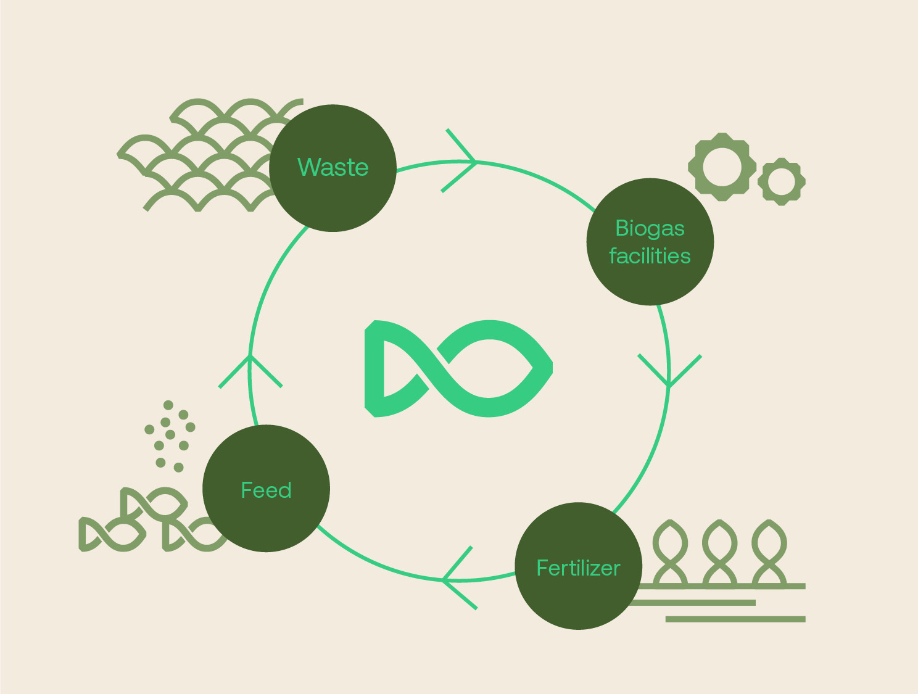
We can make aquaculture circular
Recirculated Aquaculture Systems (RAS) is a closed system with high control of the production (approx. 75% water is reused)
Nutrient waste is an issue that needs to be addressed I food production
Denmark has a strong biogas-infrastructure
By reusing the fish waste in biogas production we can
ensure circularity
Notes:
Farming fish like any other animal produces waste.
In Denmark the farmers co-own biogas facilities, where their animal waste is made into liquid fertilizer to spread in the fields.
By entering this infrastructure, we can ensure a completely circular process in fish farming.
The are 150 biogas facilities planned to make Denmark completely self-sufficient with gas by 2030.

Slide 14
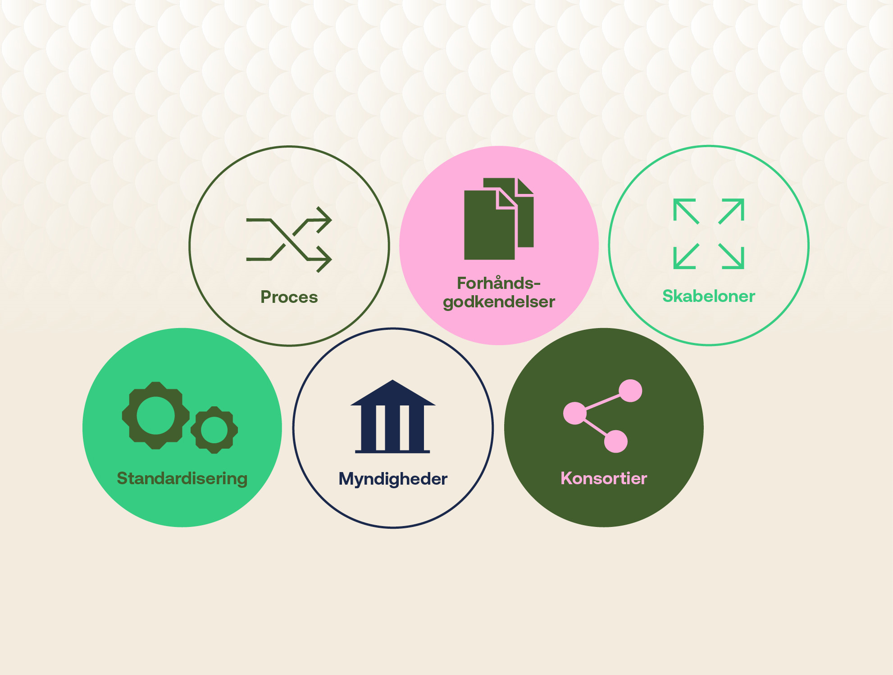

An important stepping stone to the farmers
GreenScale will contribute to simplifying the application processes through dialogue with authorities
GreenScale will help farmers join together in land-based fish farming consortia
prior
approvals
Processes
Templates
Standardization
Authorities
Consortia
Notes:
I dag kan det tage 5 år eller længere at få en tilladelse til at bygge et landbaseret fiskeopdræt.
Den proces vil vi have lempet ved at samarbejde med myndighederne om at skabe forhåndsgodkendte compliance-skabeloner til landmændene.
I dag arbejder landmændene allerede sammen om biogasanlæg mange steder. Det er samme model, vi forestiller os, kan udvides til også at omhandle landbaseret fiskeopdræt.

Slide 15
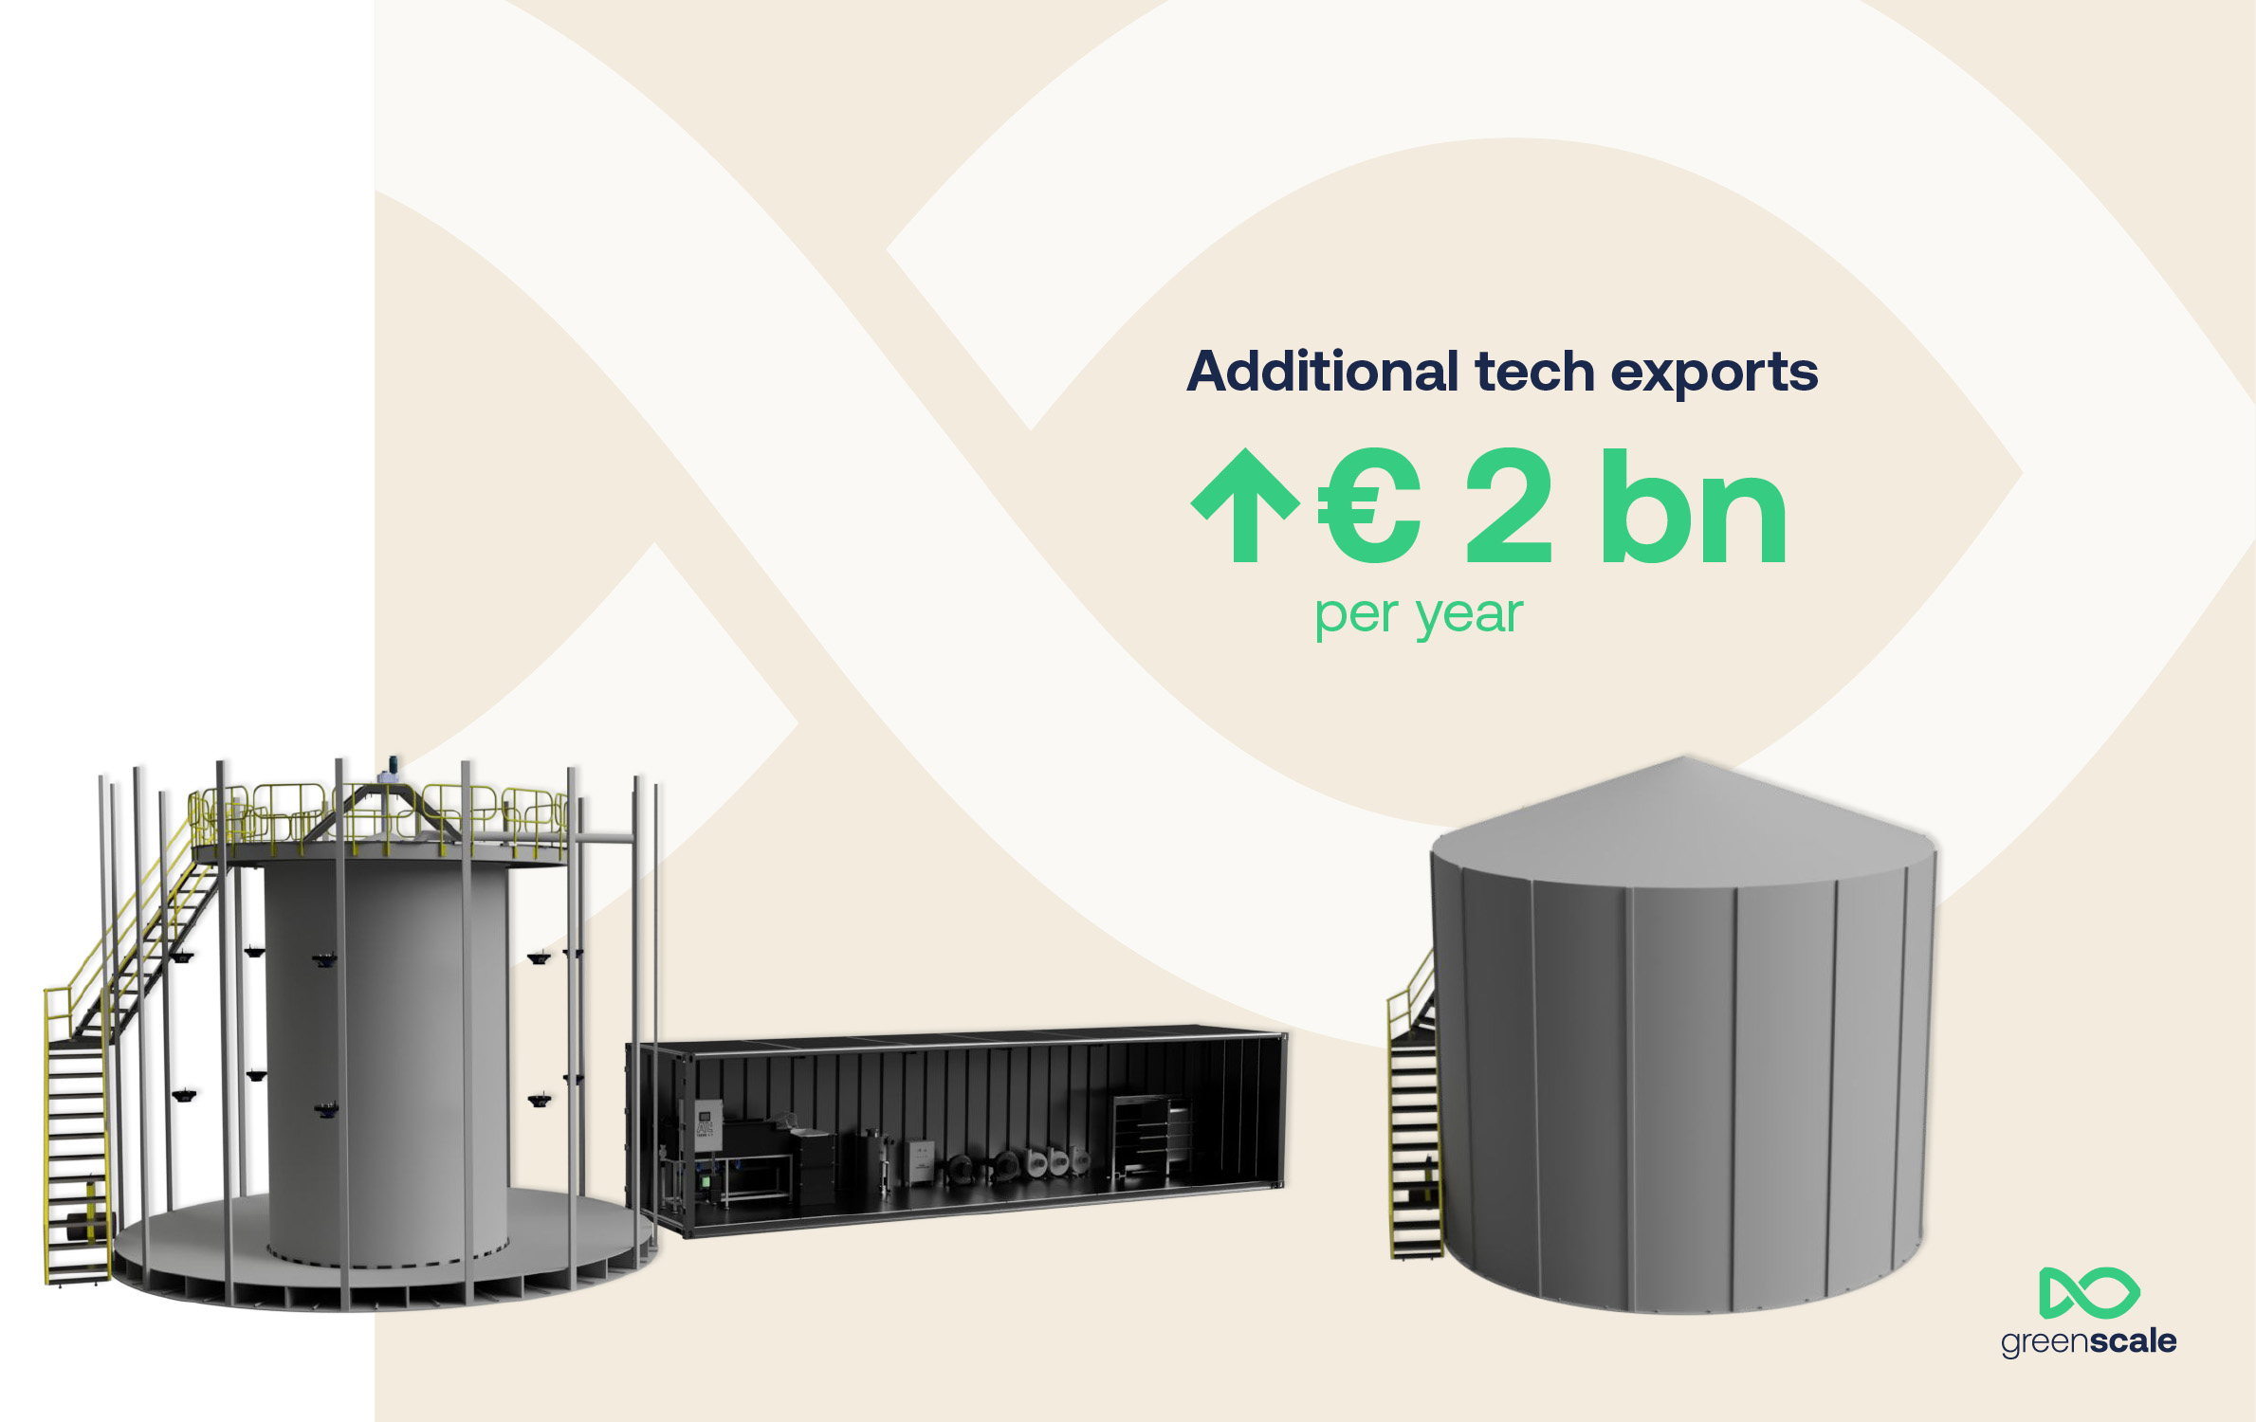
Standardization
is key
There is great potential in exporting aquaculture
technology
We need to invent standardized facilities, ratios and scorecards
When standardized production facilities prices will go down
By standardizing we can
make the whole world
our market for the technologies
RAS
Recircular Aquacultur System
Plant
investments
3-7 €
Photo: Farm in a Box

Slide 16
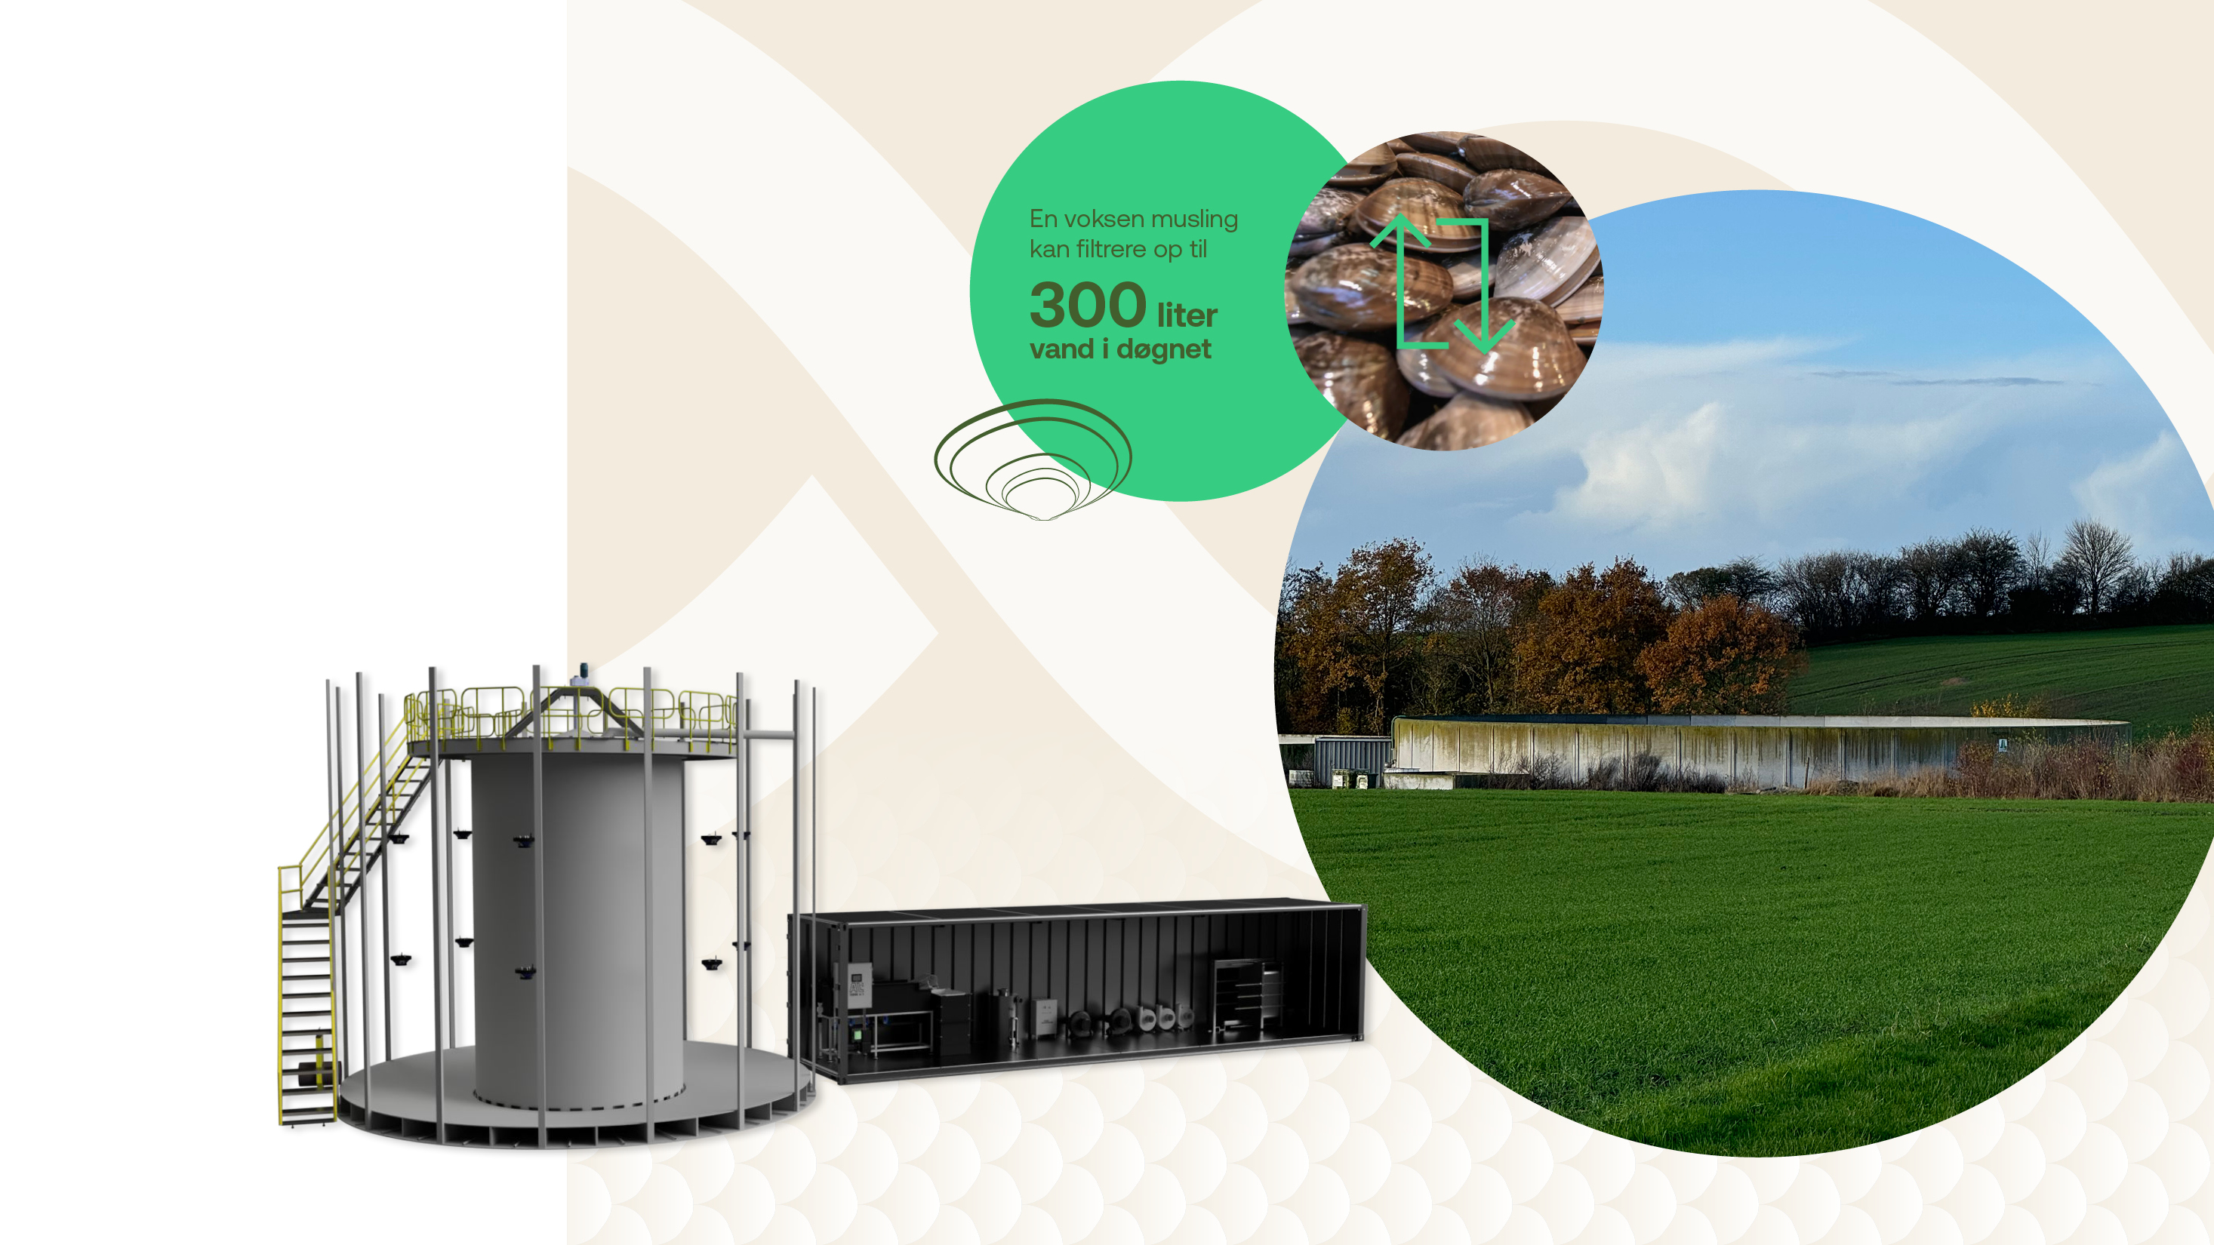
Innovation
is key
A grown mussel filters
300 litres per day
Can existing farm building be used?
Can mussels be used as a supplement to biofilters for water purification?
Can willow plantations etc. Help absorb the last nutrients from the filtered discharge?
Photo: Farm in a Box
Kilde: https://flotvand.dk/vandrensning/

Slide 17
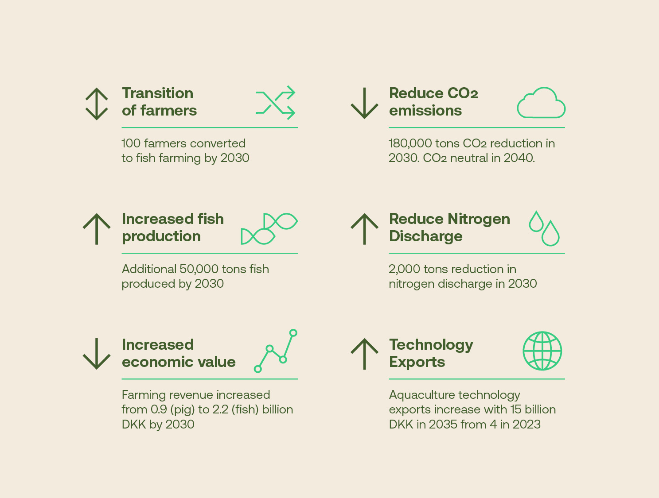
Creating a real difference
GreenScale are ambitious both
regarding sustainability
and economy

Slide 18
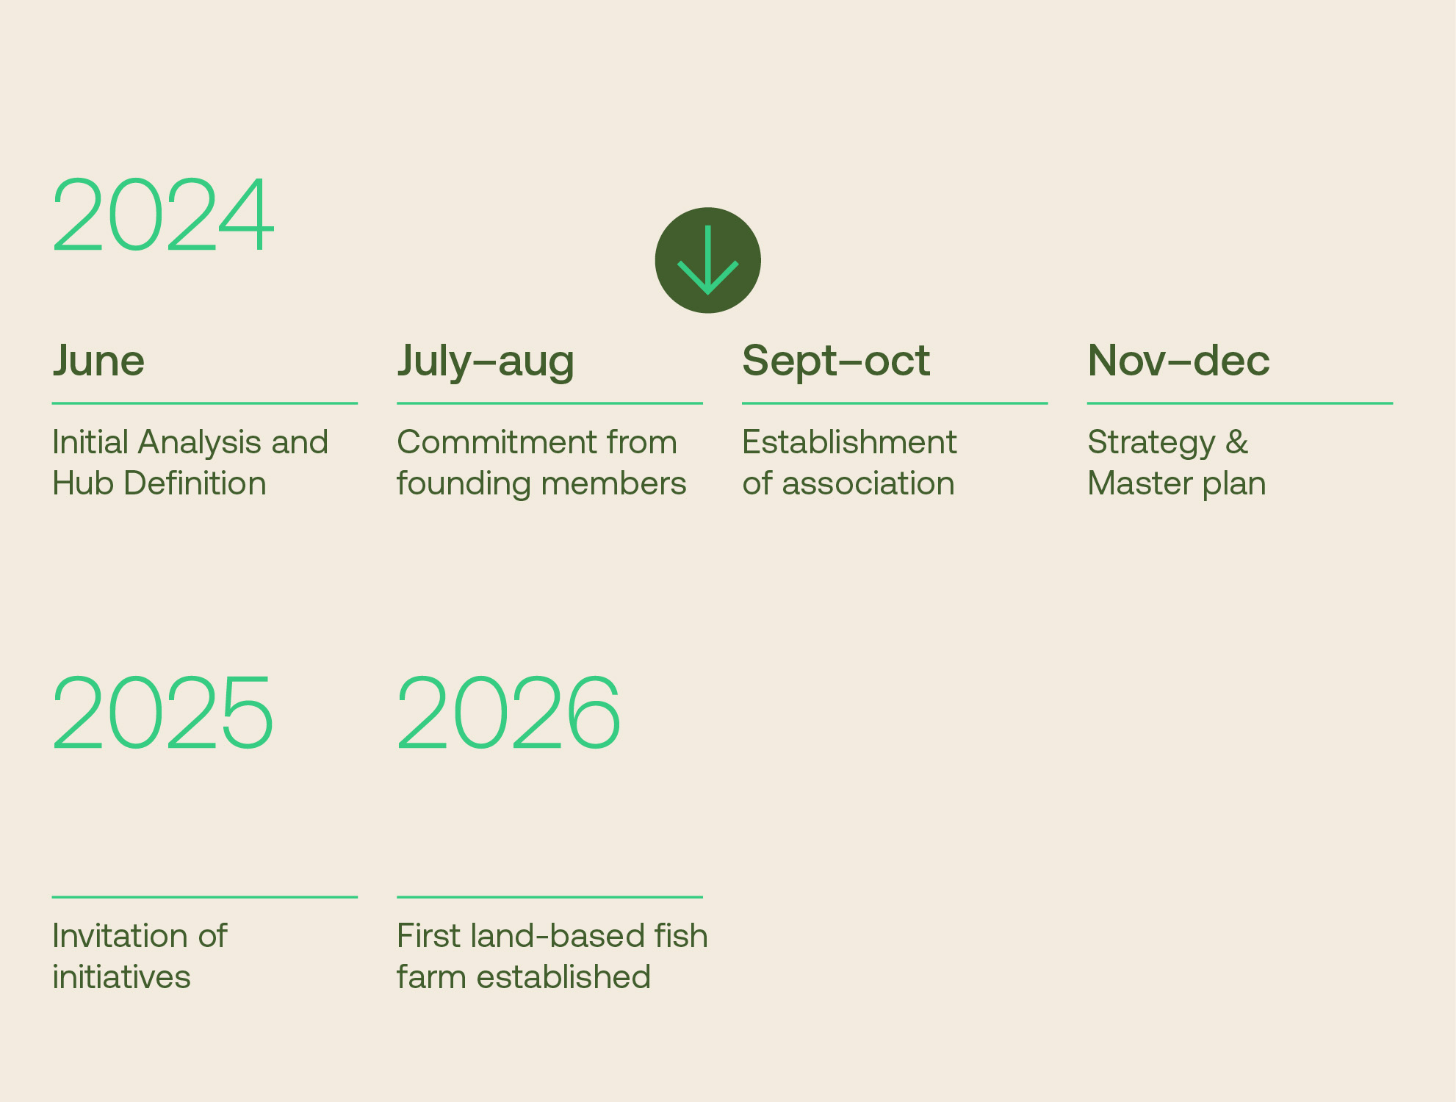
Next steps
The GreenScale office and hub will be established i 2025
The first land-based fish farm
is to be established in 2026

Slide 19
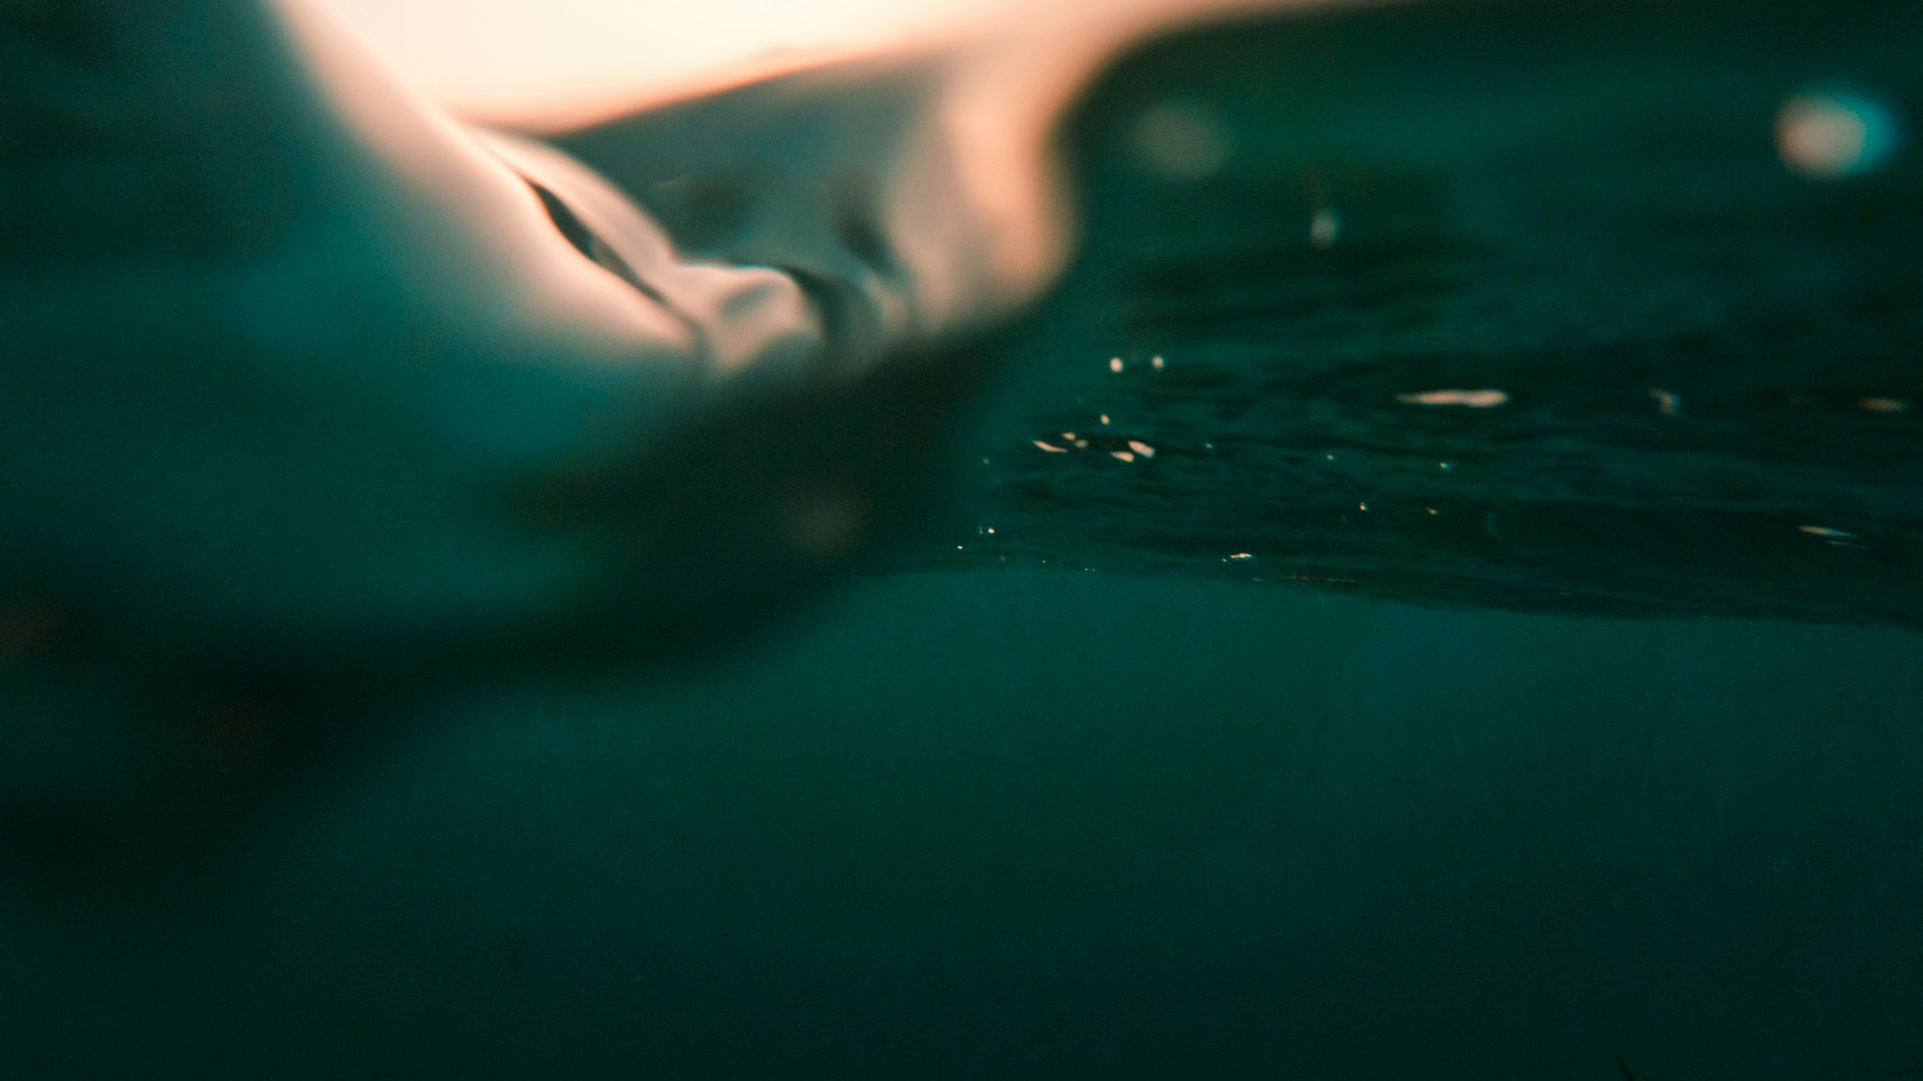
” We believe that aquaculture holds the answer to many of the problems the world face today. Especially if we can farm fish on land big scale.”

Slide 20
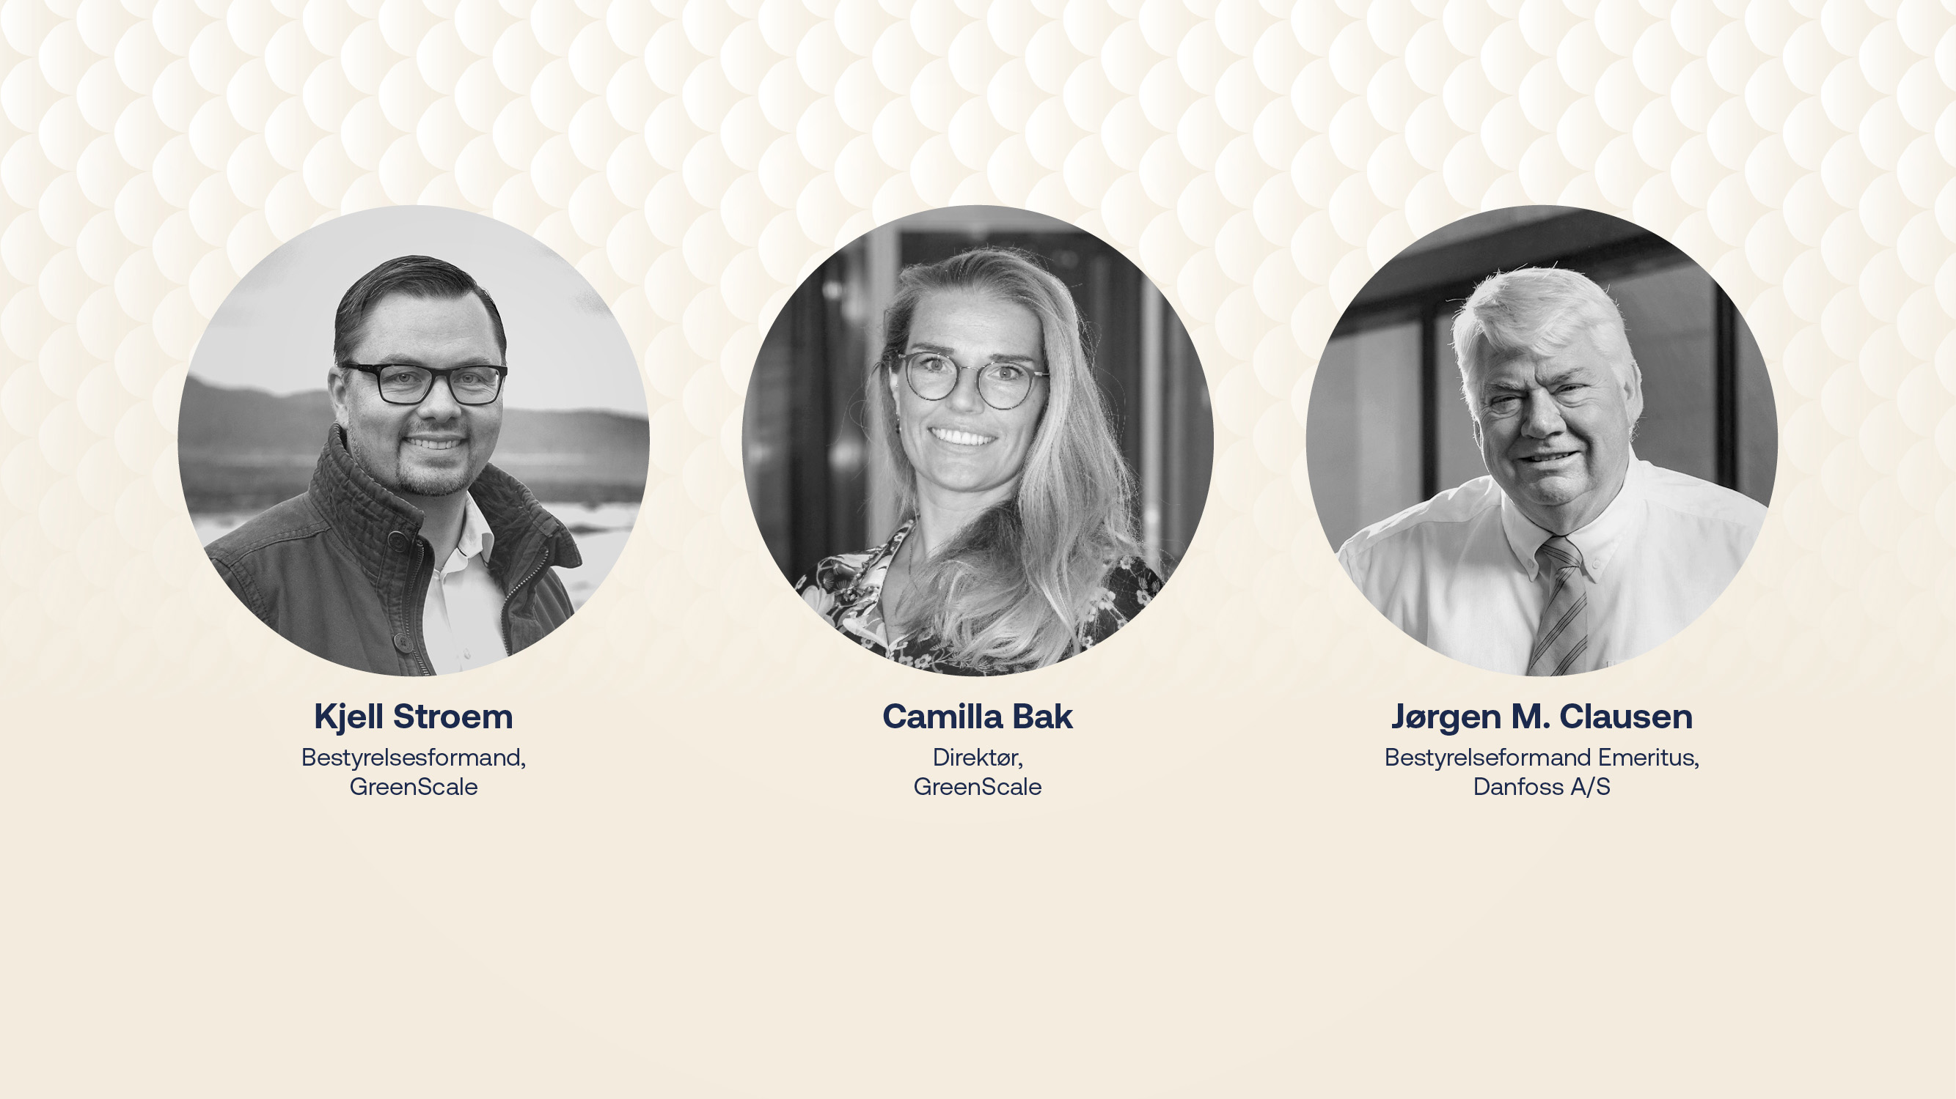

greenscale.dk

